Slide 1

DEPARTMENT OF COMPUTER SCIENCE & ENGINEERING
SDM INSTITUTE OF TECHNOLOGY
“MULTIPLE DISEASE PREDICTION”
Under the guidance of
Mr. Pradeep G S
Asst. Professor
Department of CSE
SDMIT, Ujire
Presented By
Sannidhi Rai
Susha Jain
Pradnyan Hegde
Punith L
TEAM ID: 2024CSEPT23

Slide 2
INTRODUCTION
Machine Learning is the domain that uses past data for predicting. Machine Learning is the understanding of computer system under which the Machine Learning model learn from data and experience.
Now day’s heart diseases are growing rapidly by busy and stress full life. All type of age groups is under diseases so need of early detection of disease by using symptoms or reports
We are applying complete machine learning concepts to keep the track of patient’s health. ML model allows us to build models to get quickly cleaned and processed data and deliver results faster.

Slide 3
LITERATURE SURVEY
In the paper titled “Multiple Disease Prediction Using Machine Learning Algorithms” [1], the author Chauhan et al. (2021) have investigated using various ML algorithms, including SVM and Decision Trees, for multiple disease prediction, focusing on symptoms as input. It examines the performance of these algorithms on four diseases, including heart disease and diabetes. The authors emphasize the potential of predictive analytics in healthcare to assist practitioners in making timely decisions regarding patients' health. The work aims to address the challenge of early recognition and diagnosis of harmful diseases, given the shortage of medical infrastructure and a low ratio of doctors to the population.The paper unifies multiple diseases under a single user interface for predictions and highlights the significance of early detection in saving lives. The study is conducted by Indukuri Mohit, K. Santhosh Kumar, Avula Uday Kumar Reddy, and Badhagouni Suresh Kumar from Vardhaman College of Engineering, Hyderabad, India.

Slide 4
LITERATURE SURVEY
In the paper titled “Symptoms Based Multiple Disease Prediction Model using Machine Learning Approach” [2], the author Kolli et al. (2021) have proposed symptom-based disease prediction using various ML algorithms like Random Forest, Decision Trees, and LightGBM. While it focuses on 41 diseases, you could adapt the methodology to your specific diseases of interest. The system's predictions are reported to be highly accurate, and it is designed to assist medical professionals in making more informed decisions and providing better-targeted therapies. The work is a valuable contribution to the field of healthcare, offering a holistic and integrated approach to disease risk, early detection, and personalized interventions. The paper is available in the International Journal of Innovative Technology.

Slide 5
LITERATURE SURVEY
In the paper titled “A Machine Learning Model for Early Prediction of Multiple Diseases to Cure Lives” [3], the author Kamboj et al. (2020) have proposed a framework for early disease prediction using an ensemble model combining Logistic Regression, SVM, and K-Nearest Neighbors. It showcases the effectiveness of this approach for multiple diseases, potentially including your chosen ones. The paper provides insights into the application of machine learning in healthcare for the early prediction of multiple diseases, emphasizing the importance of accurate predictions and timely interventions to improve patient outcomes.

Slide 6
LITERATURE SURVEY
In the paper titled “Multiple Disease Prediction Using Hybrid Deep Learning Architecture” [4], the author Al-Mallah et al. (2016) have explored using a hybrid deep learning architecture for multiple disease prediction, encompassing diseases like diabetes and heart disease. Studying their approach might provide insights for applying deep learning techniques to your project. The authors utilize a comprehensive dataset of medical records and symptoms of various diseases, which are then analyzed using deep learning techniques such as Convolutional Neural Networks (CNN) and Long Short-Term Memory (LSTM) networks. The proposed system involves three phases: data normalization, weighted normalized feature extraction, and prediction. The system's predictions are reported to be highly accurate, and it can assist medical professionals in making more informed decisions and providing better-targeted therapies. The work is a valuable contribution to the field of healthcare, offering insights into the application of deep learning for disease prediction and highlighting the potential of hybrid deep learning architectures to improve model performance.

Slide 7
LITERATURE SURVEY
In the paper titled “Predictive Modeling for Multiple Diseases Using Machine Learning with Feature Engineering” [5], the author Krishnaiah et al. (2015) : This paper delves into feature engineering techniques for improving multiple disease prediction using KNearest Neighbors and Fuzzy K-NN approaches. This could be helpful for optimizing your feature selection and data preparation. The work is a valuable contribution to the field of healthcare, offering insights into the application of machine learning for disease prediction and highlighting the potential of feature engineering techniques to improve model performance. The paper is available in the International Research Journal of Modernization in Engineering Technology and Science. The paper emphasizes the importance of feature selection, model optimization, and comparative analyses for the development of accurate and reliable disease prediction models

Slide 8
PROBLEM STATEMENT
Many of the existing machine learning models for health care analysis are concentrating on one disease per analysis. For example first is for liver analysis, one for cancer analysis, one for lung diseases like that.
If a user wants to predict more than one disease, he/she has to go through different sites. There is no common system where one analysis can perform more than one disease prediction.

Slide 9
OBJECTIVES
1. Early Detection: Develop machine learning models to accurately predict the onset of heart disease, diabetes, and Parkinson's, enabling timely intervention.
2. User-Friendly Tool: Create an accessible diagnostic tool using Streamlit, making it easy for healthcare providers to use the predictive models.

Slide 10
3. Resource Accessibility: Focus on making the diagnostic solution available in resource-limited areas to improve healthcare access for underserved populations.
4. Impact Assessment: Evaluate the effectiveness of the predictive models in real-world settings to measure improvements in patient outcomes and overall public health.

Slide 11
HARDWARE AND SOFTWARE REQUIREMETS
Hardware Requirements:
Sl. No | Hardware/Equipment | Specification
1. | Graphics Card | Intel 621 Graphics card or 2GB
2. | RAM | 4GB or above

Slide 12
Software Requirements
Sl. No | Software | Specification
1. | Anaconda | Anaconda 64 bit
2. | Python | Python 3 and above
3. | Framework | Streamlit

Slide 13
METHODOLOGY
The proposed multiple disease prediction system is implemented using the following steps:
Data collection: Gather data related to patients, such as demographic information (age, gender), medical history, clinical test results (blood pressure, cholesterol) and genetic data.
Data pre-processing: Then the next step is data pre-processing. It is the process of converting raw data into a clean data. In this process missing values, noisy and inconsistent data in the dataset are handled.

Slide 14
Train Test split: Here data is split for training and testing purpose. 70% of the data is used to train the model and remaining 30% of the data is used for testing. Then dataset will be trained using Support Vector Machine classifies and Logistic Regression.
Modelling: After the training and testing of the models, confusion matrix is plotted, and accuracy score is computed for each algorithm. Then based on the accuracy score best suited algorithm for the prediction of disease is identified.

Slide 15
APPLICATIONS
1. Doctor’s Tool: Help doctors identify health risks early and make better treatment decisions.
2. Health Screenings: Use the tool in community health events to find at-risk individuals.
3. Remote Care: Provide online consultations for patients in distant areas, improving access to healthcare.

Slide 16
4. Patient Awareness: Educate patients about their health risks to encourage healthier lifestyle choices.
5. Research Support: Analyze data to improve understanding of diseases and enhance predictive models.

Slide 17
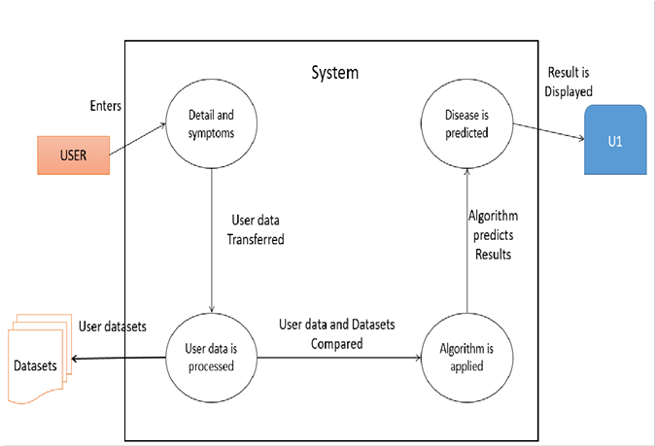
SYSTEM DESIGN
System Architecture

Slide 18
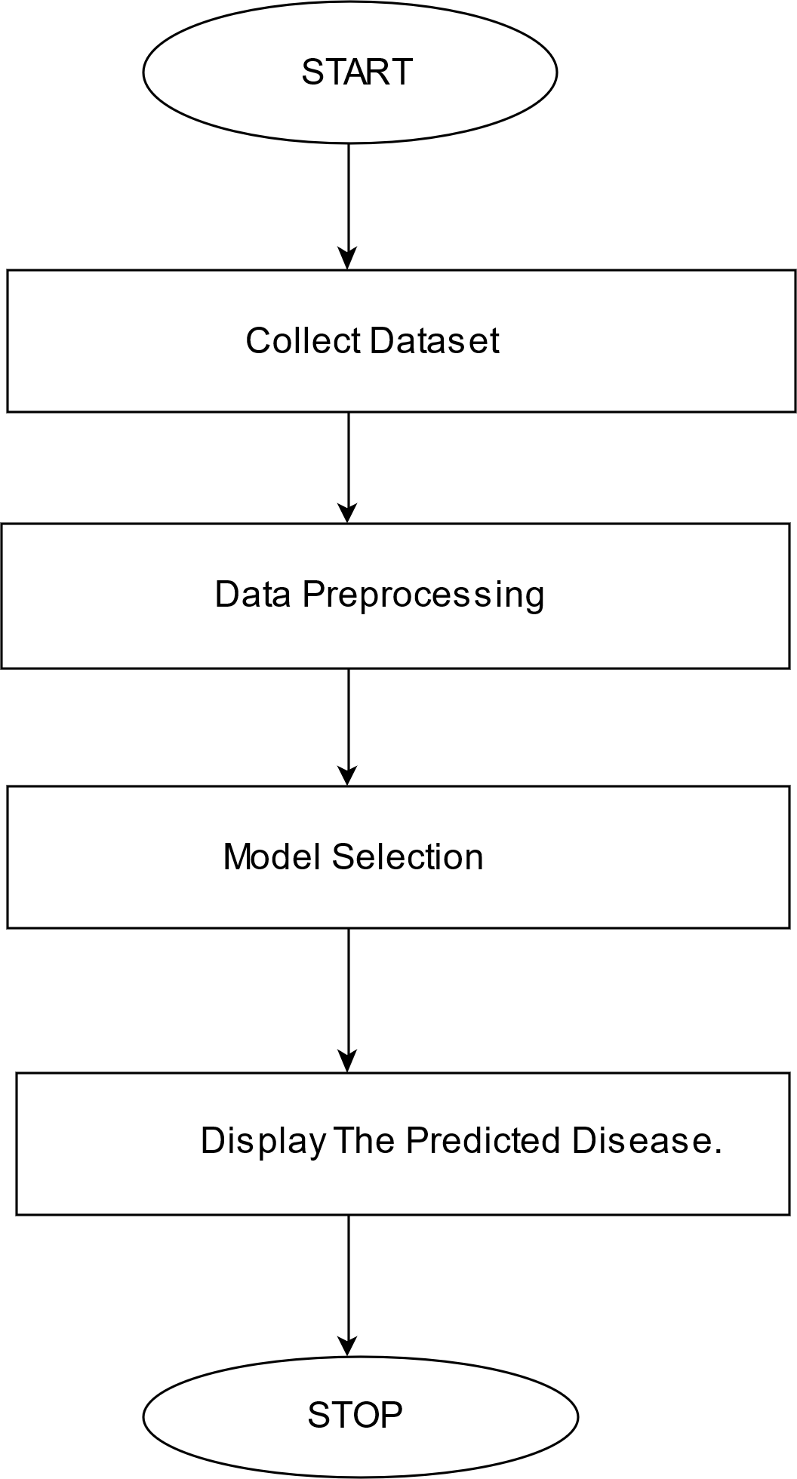
System Flowchart

Slide 19
ALGORITHMS
In our multiple disease prediction project, we utilized Support Vector Machines (SVM) and the Logistic Regression model to achieve accurate and reliable results.
SVM is a robust classification algorithm that works by finding the optimal hyperplane that separates data points into distinct classes.
It is particularly effective in handling high-dimensional datasets and ensures maximum margin separation, which makes it suitable for complex medical data with multiple features.

Slide 20
Logistic Regression, on the other hand, is a widely-used statistical model for binary and multi-class classification. It predicts the probability of an outcome using a sigmoid function and is highly interpretable, making it ideal for understanding relationships between predictors and disease outcomes.
Together, these algorithms provided a comprehensive approach for predicting diseases, leveraging the strengths of SVM in handling non-linear relationships and Logistic Regression for its simplicity and interpretability in binary classification scenarios.

Slide 21
DATASETS
The datasets were sourced from Kaggle and are well-suited for training models such as SVM and Logistic Regression.

Slide 22
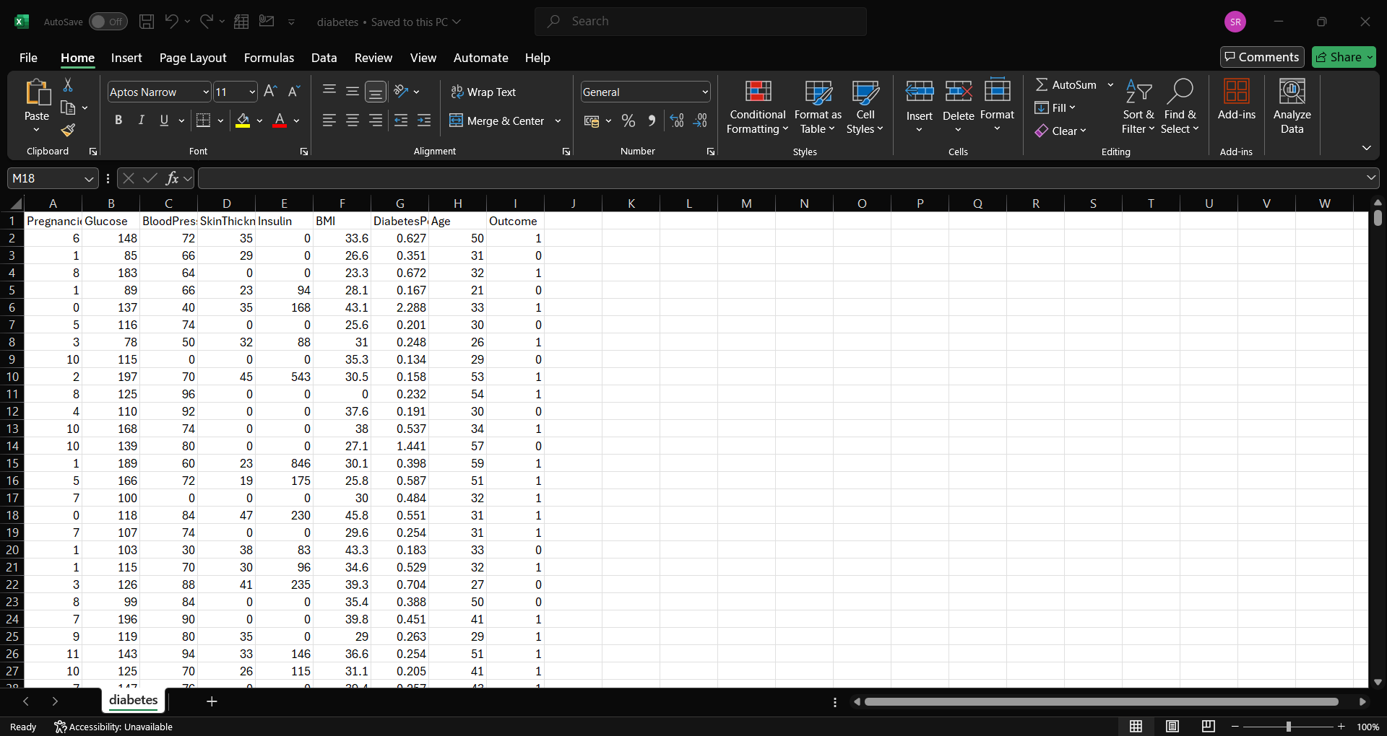
Diabetes Dataset(768)

Slide 23
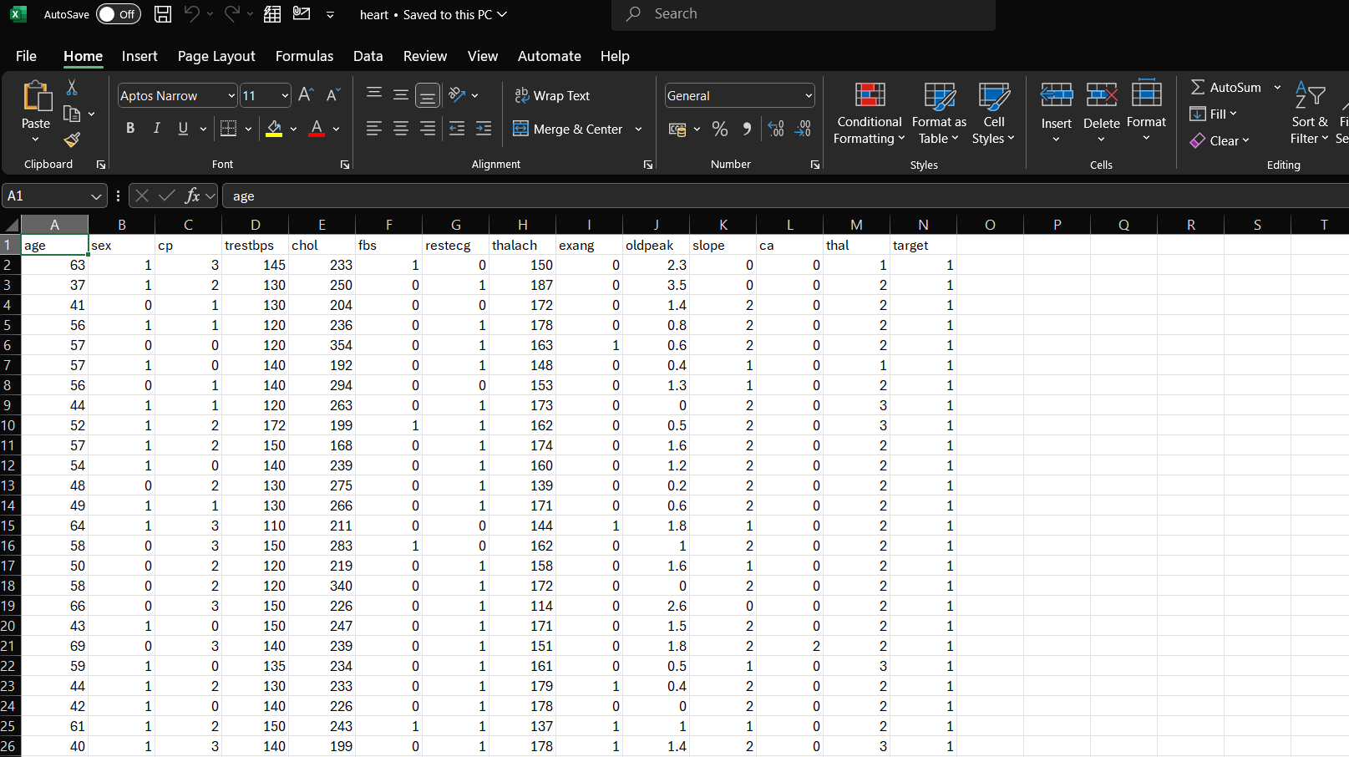
Heart Disease dataset(303)

Slide 24
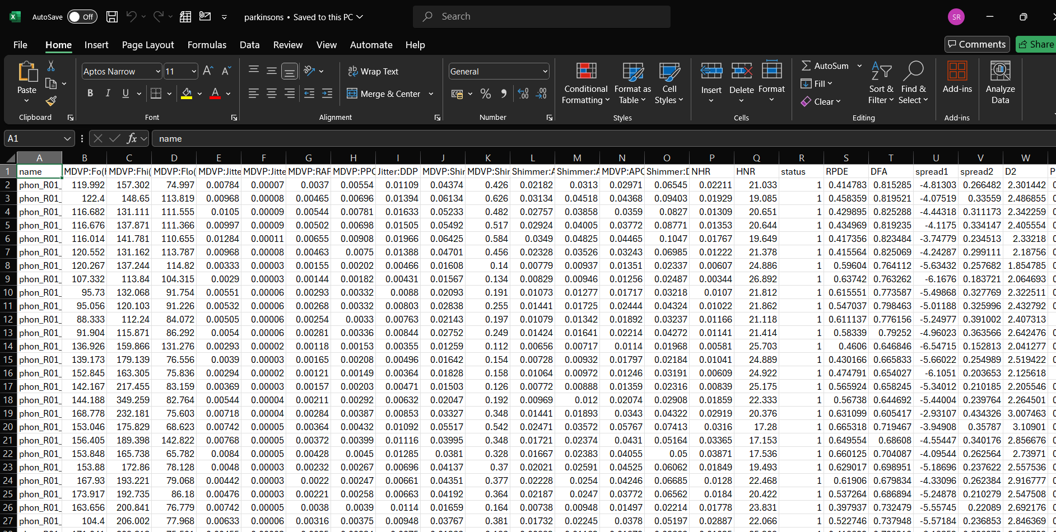
Parkinson’s Dataset(195)

Slide 25
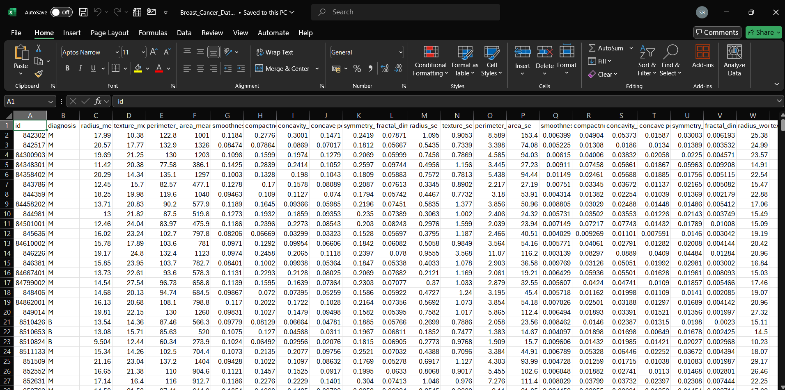
Breast Cancer Dataset(569)

Slide 26
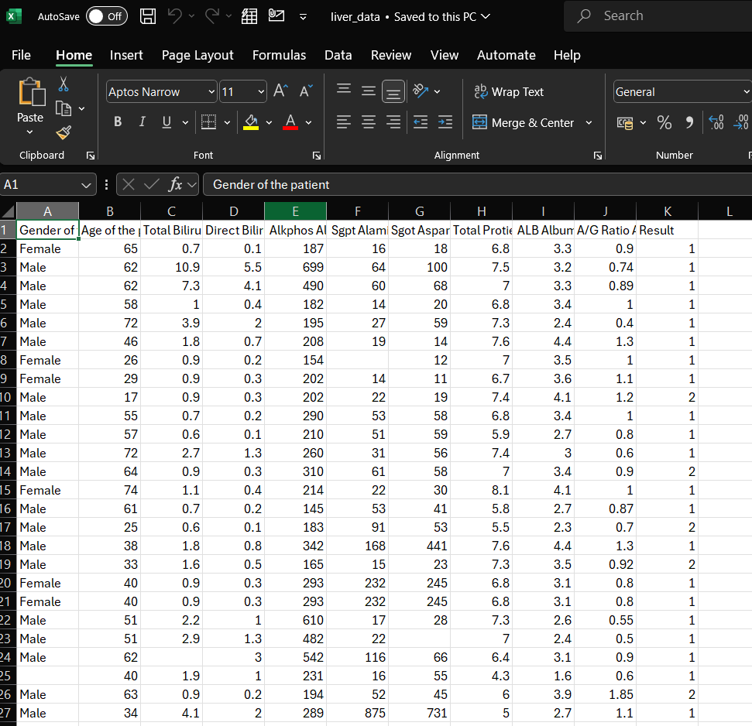
Liver Disease Dataset(30691)

Slide 27
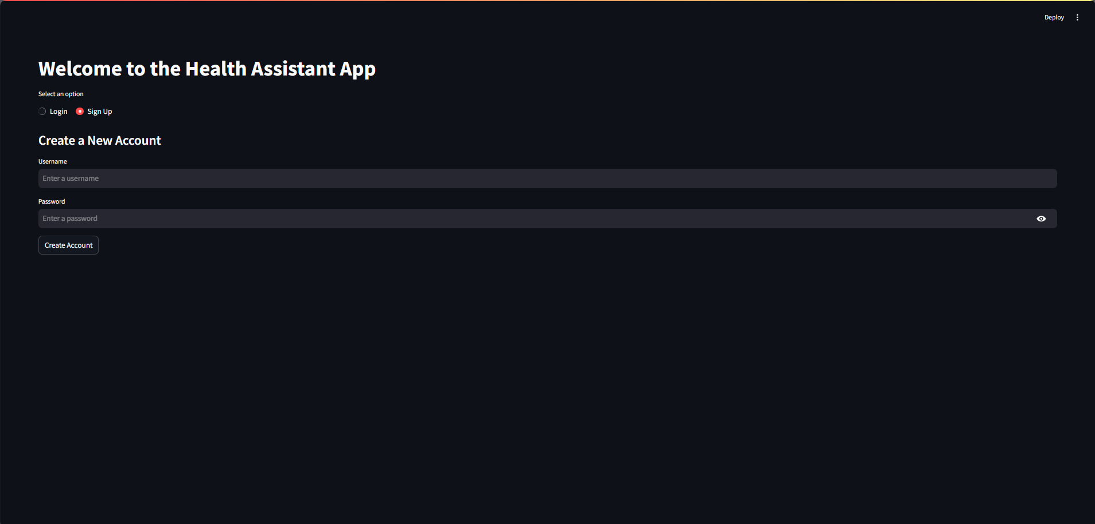
IMPLEMENTATION
Create an account for the user

Slide 28
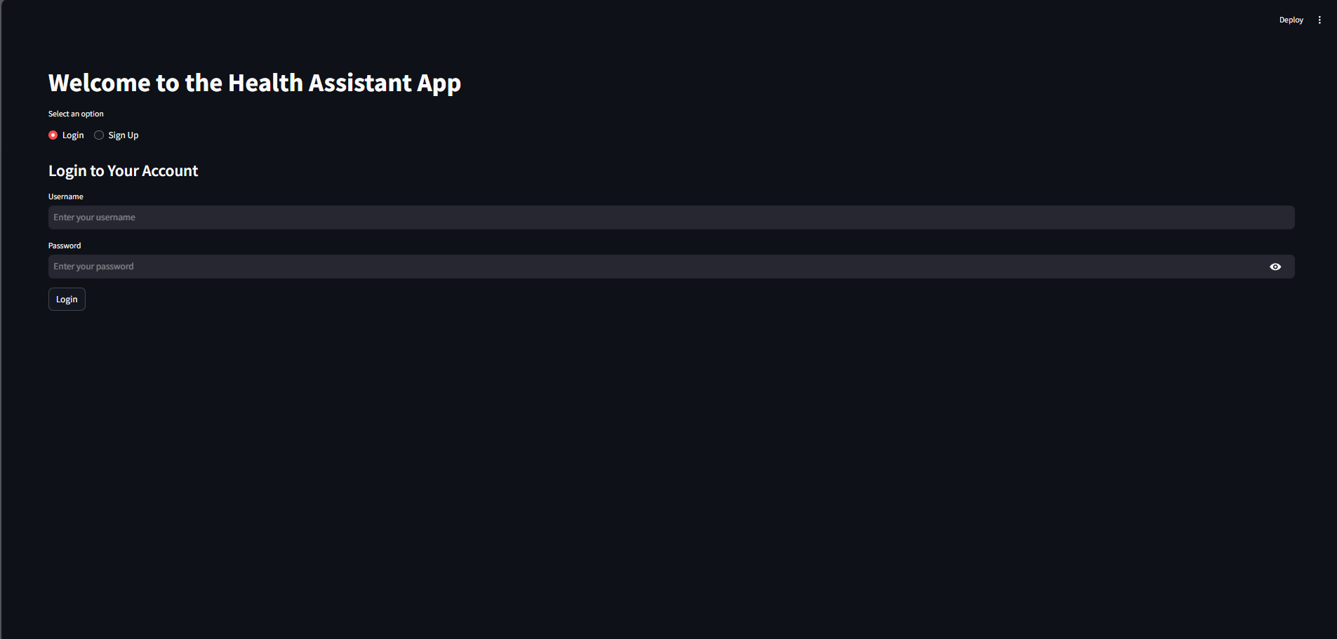
Login page

Slide 29
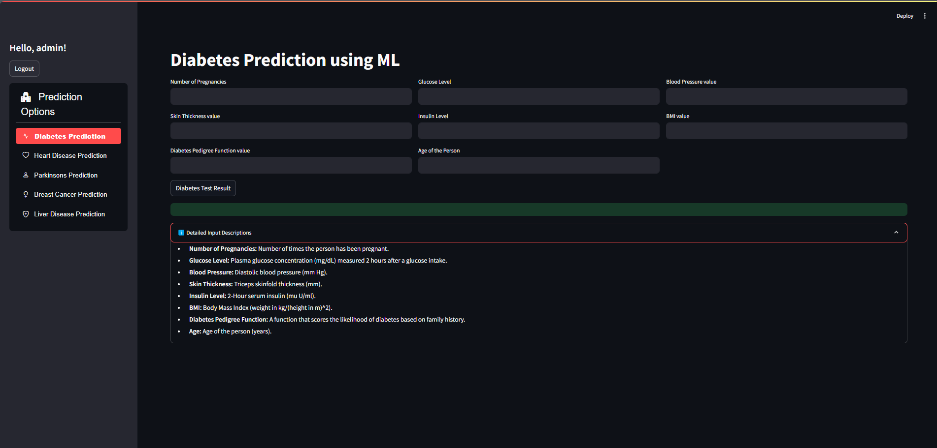
Diabetes prediction page

Slide 30
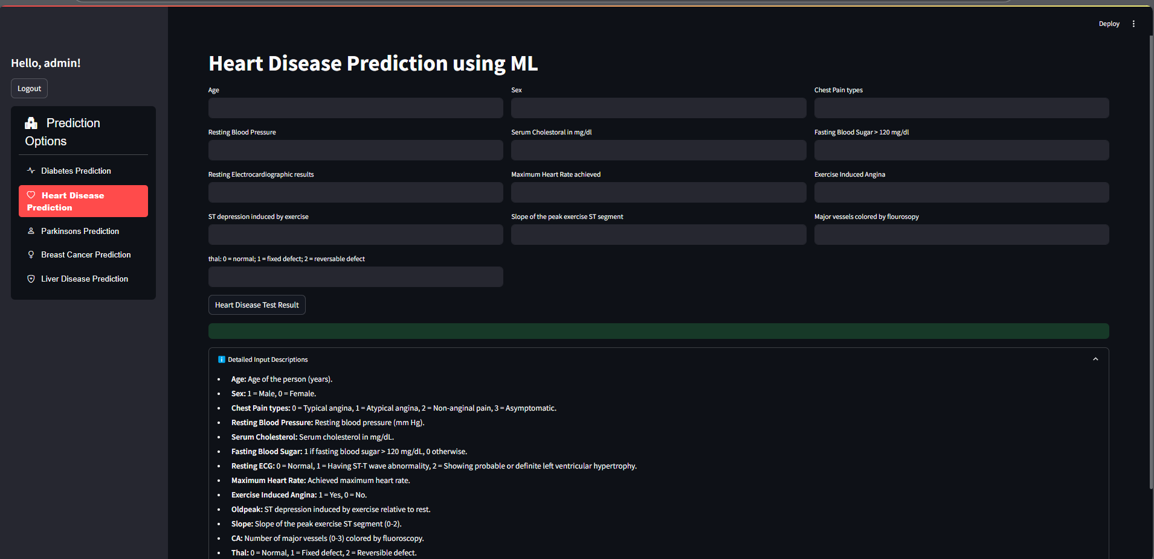
Heart Disease prediction page

Slide 31
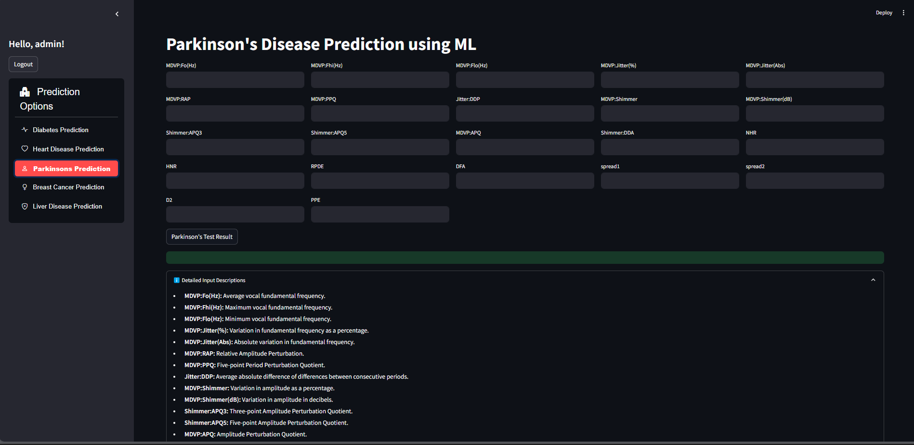
Parkinson’s prediction page

Slide 32
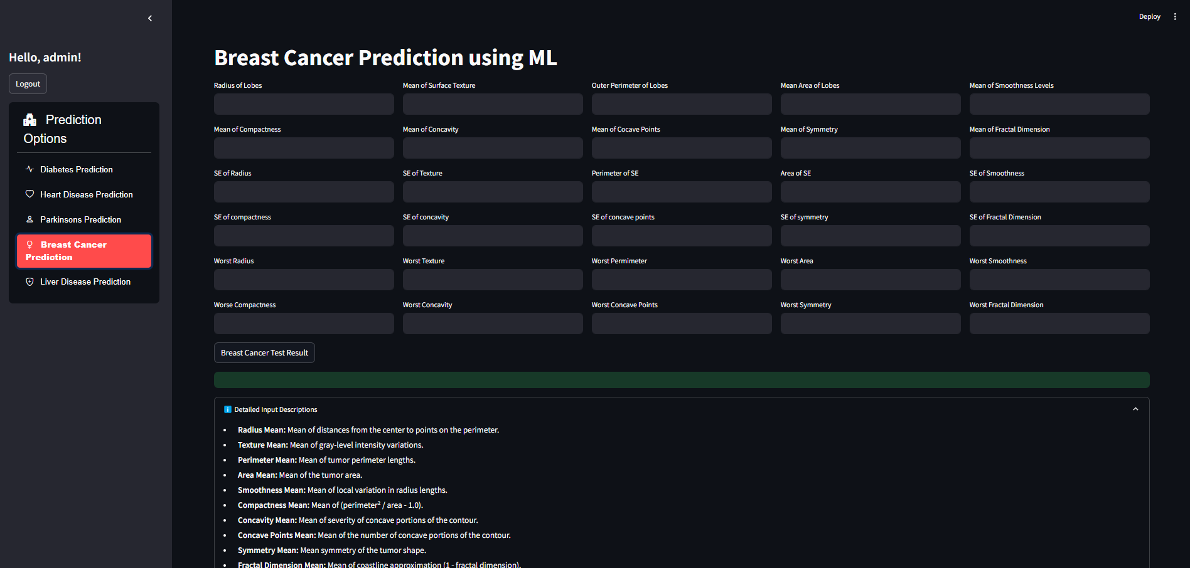
Breast Cancer prediction page

Slide 33
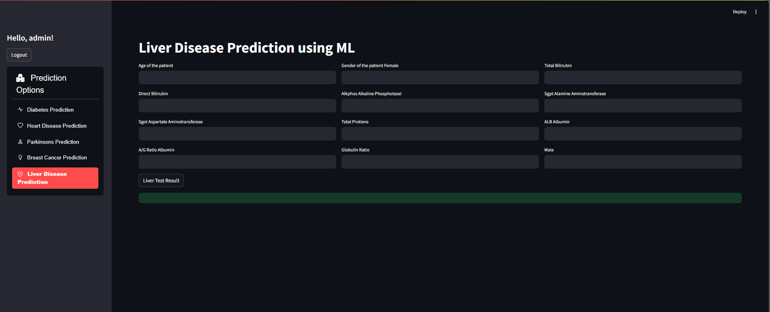
Liver Disease prediction page

Slide 34
SYSTEM TESTING
Test case number | Input | Stage | Expected Behaviour | Observed Behaviour | Status P=Pass F=Fail
1 | Upload the
2
3
4
5

Slide 35
Result Analysis
Training Size | Testing Size | Accuracy (%) of diseases using Support Vector machine Classification
 |  | diabetes | Parkinson’s | Breast cancer
80% | 20% | 78.33 | 87.18 | 96.92
70% | 30% | 78.03 | 88.97 | 96.98

Slide 38
Training Size | Testing Size | Accuracy (%) of diseases using Logistic Regression Model
 |  | Heart disease | Liver disease
80% | 20% | 85.12 | 71.42
70% | 30% | 84.43 | 71.43

Slide 41
CONCLUSION & SCOPE FOR FUTURE WORK
In the future we can add more diseases in the existing API.
We can try to improve the accuracy of prediction in order to decrease the mortality rate
Try to make the system user-friendly and provide a chatbot for normal queries

Slide 42
REFERENCES
[1] C. Chauhan, et al., "Multiple Disease Prediction Using Machine Learning Algorithms," 2021.
[2] S. Kolli, et al., "Symptoms Based Multiple Disease Prediction Model using Machine Learning Approach," 2021.
[3] A. Kamboj, et al., "A Machine Learning Model for Early Prediction of Multiple Diseases to Cure Lives," 2020.
[4] H. Al-Mallah, et al., "Multiple Disease Prediction Using Hybrid Deep Learning Architecture," 2016
[5] P. Krishnaiah, et al., "Predictive Modeling for Multiple Diseases Using Machine Learning with Feature Engineering," 2015.

Slide 43
Thank You

